Slide 1
Superlime
- A Cloud Java IDE
-24783 Advanced Engineering Computation
Team: Fangcheng Zhu zewen wang ximing li
Yihui wang zao lou

Slide 2
Our Initial Goal
Superlime client
Offline: Users edit Java source files on local machine
Online: Send compile/run requests to server
Superlime server
Long-running server deployed on the cloud

Slide 3
What we have done
● Open/Close/Write Files
● Word highlighting
● Directory Tree
● Project file adding
● Zoom in/out
● Compile
● Show output/error
● Search in code
● Automatic Indentation
● Full screen
Server:
● Java (JDK 8)
● Process
● Socket
Client:
● Save File
● Socket
● Display

Slide 4
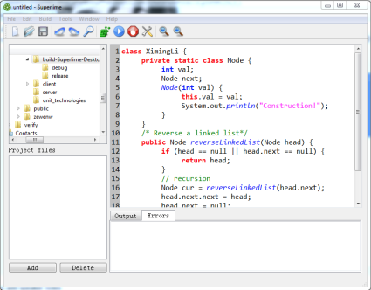
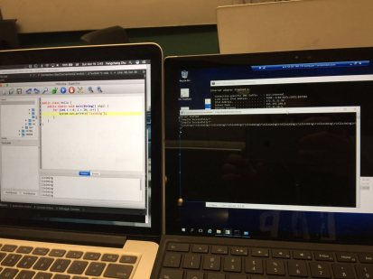
What we have done

Slide 5
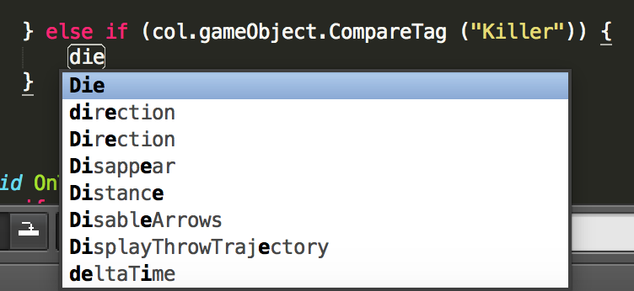
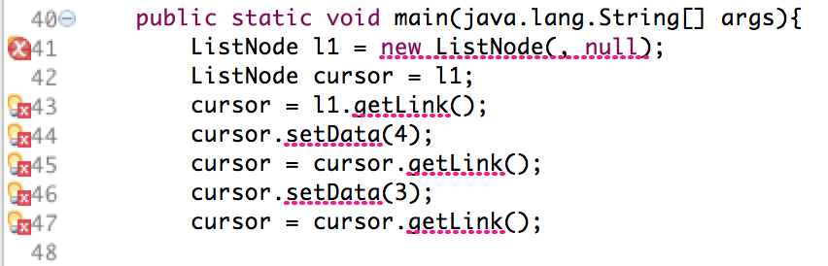
Coming soon...
● Provide associative defined things (functions, variables, class, etc.)
● Display line numbers of error in console after compile
● etc.

Slide 6
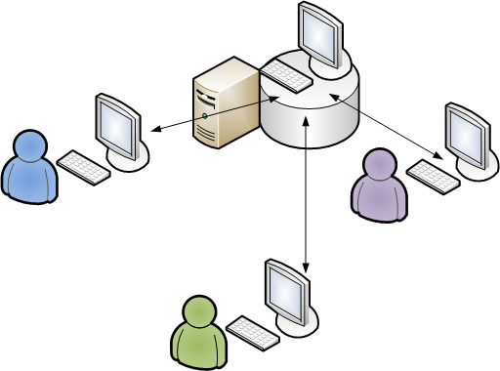
What is not deliverable
● Can’t handle multi-client connections
● Only deploy server in Windows/Linux

